Slide 1
Twitter Sentiment Analysis COVID-19

Slide 2
Introduction & Insights
Sentiment Analysis is a technique used in text mining. It may,
therefore, be described as a text mining technique for
analyzing the underlying sentiment of a text message, i.e., a
tweet.
To do this analysis we will be using IBM Watson Tone analyser
and we will feed a tweet into and get a result as a different
tones. This tone analyser outputs Anger, Fear, Joy,
Sadness, Analytical , Confident, Tentative tones as output.

Slide 3
Why Twitter Sentiment Analysis
Business: Companies use Twitter Sentiment Analysis to develop
their business strategies, to assess customers feelings towards
products or brand, how people respond to their campaigns or product
launches and also why consumers are not buying certain products.
Politics: In politics Sentiment Analysis Dataset Twitter is used to keep
track of political views, to detect consistency and inconsistency
between statements and actions at the government level.
Public Actions: Twitter Sentiment Analysis also is used for monitoring
and analyzing social phenomena, for predicting potentially dangerous
situations.

Slide 4
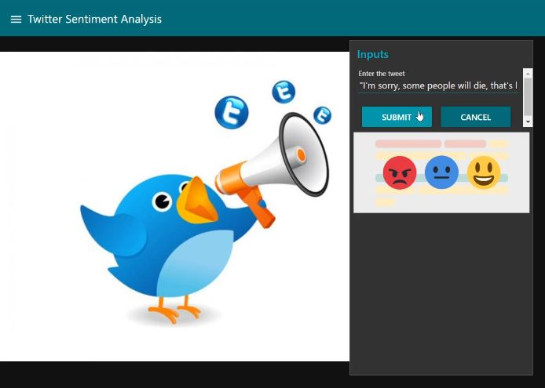
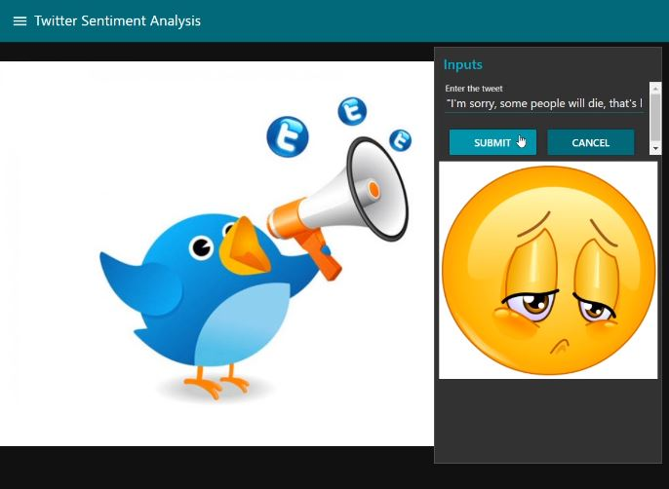
Demo Project
In this given UI we feed tweet into the text box and result in shown in the picture
form as shown in the given pictures.

